Slide 1
Example Slides
Published 07 Nov 23
South East PAT
england.datasouth@nhs.net

Slide 2
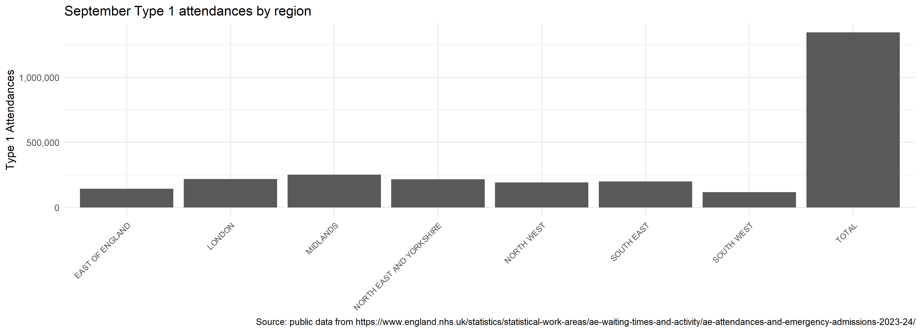
An example plot
Code run on 07 Nov 23
An example subtitle
Some example text Could be replaced with automated commentary
Source: published monthly sitrep data

